Slide 1
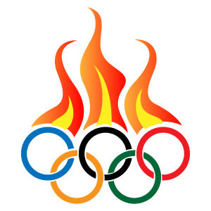
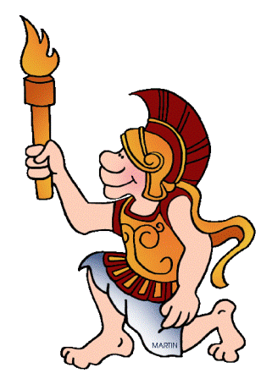
Olympic Games
Some facts, figures and pictures
http://english-study-cafe.ru/

Slide 2
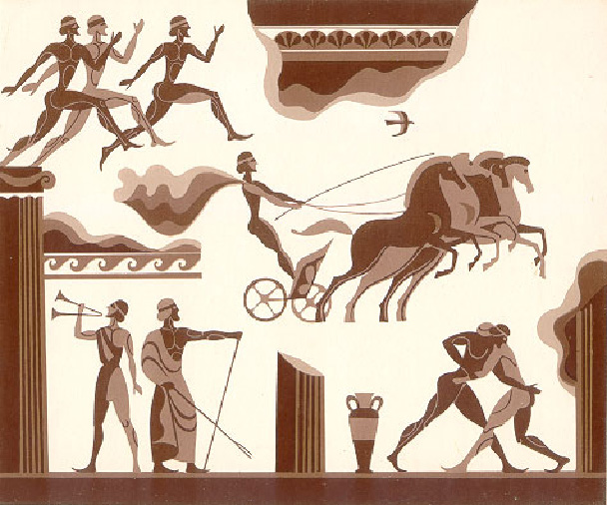
776 BC. -393 A.D.

Slide 3
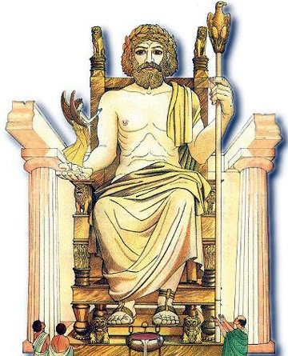
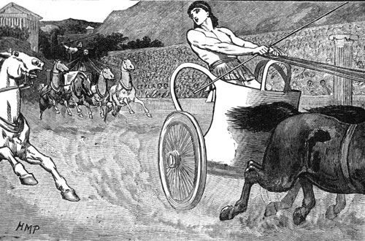
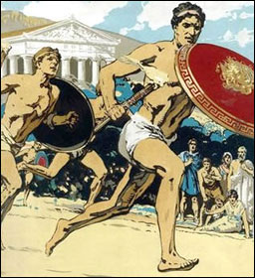
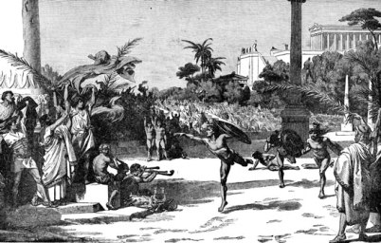
The ancient Olympics, held every four years, occurred during a religious festival honoring the Greek god Zeus.
At first there was only one event, a running race. Later horse riding, chariot racing, wrestling and other events were added.

Slide 4
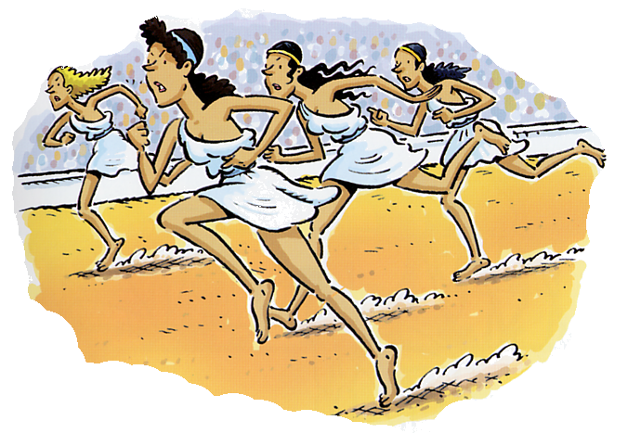
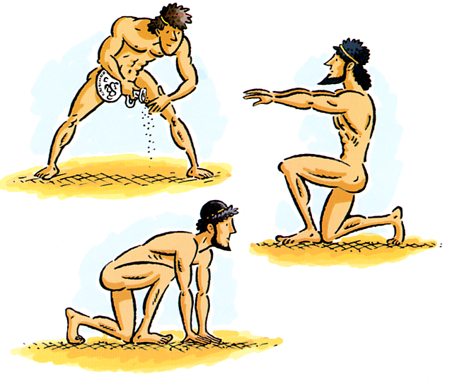
Only men took part in the games: women who wanted to race had a separate festival called the Heraia.
Women couldn’t even watch the Games, may be, because the athletes didn’t wear clothes.

Slide 5
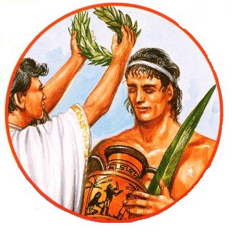
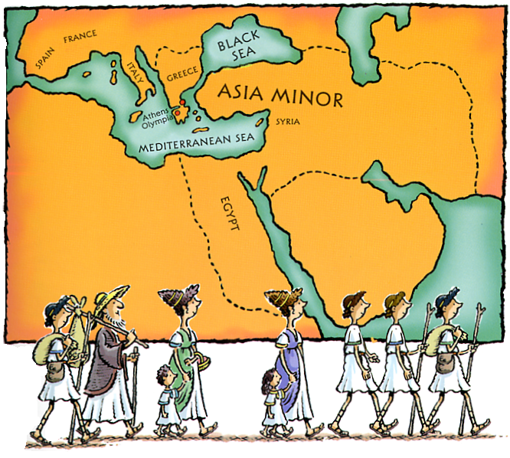
The athletes didn’t get medals, they were awarded with crowns of leaves.
All wars were stopped in Greece during the Olympics.
The stadium at Olympia could hold 20,000 people and they came from different parts of Greece and even from other countries to see the Games.

Slide 6
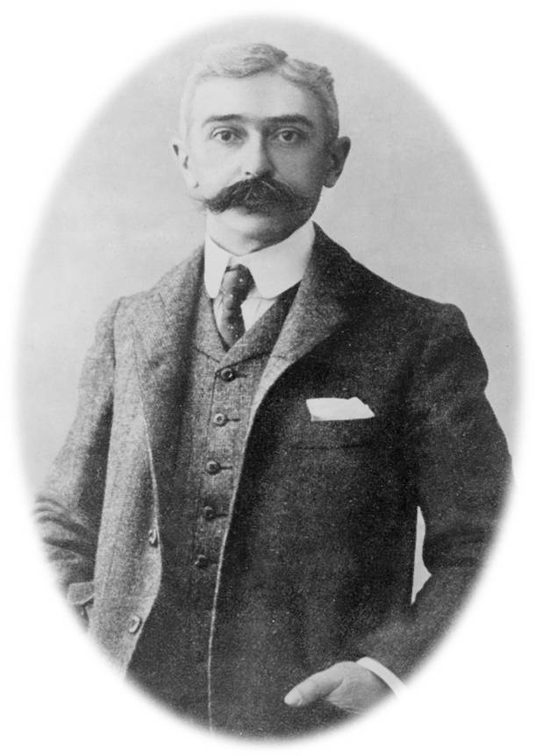
Baron Pierre de Coubertin,
a French educator and historian,
is the founder of the International Olympic Committee and
the modern Olympic Games.

Slide 7
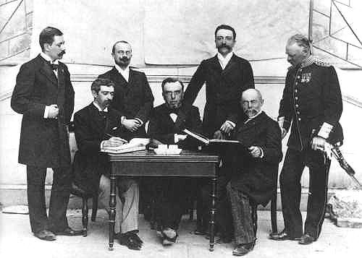
“The most important thing in the Olympic Games is not to win but to take part.” Olympic Creed
The International Olympic Committee was founded on 23 June 1894.

Slide 8
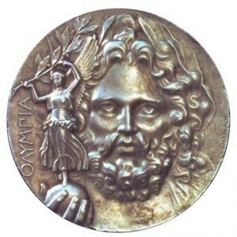
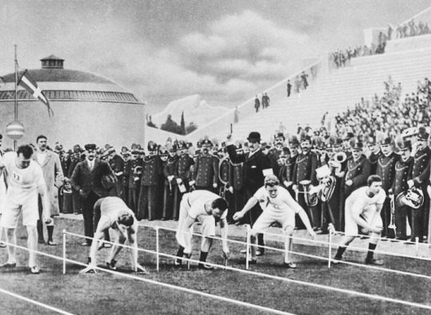
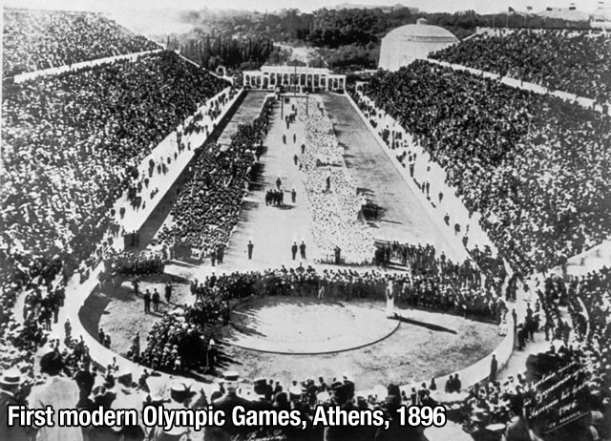
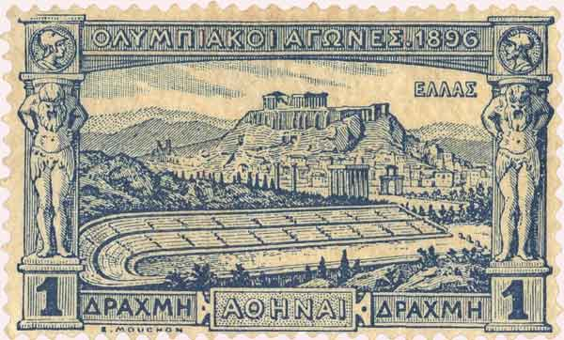

Slide 9
The Winter Olympic Games were born in 1924 and from 1924 to 1992 they were held in the same year as the Summer Games every four years.

Slide 10
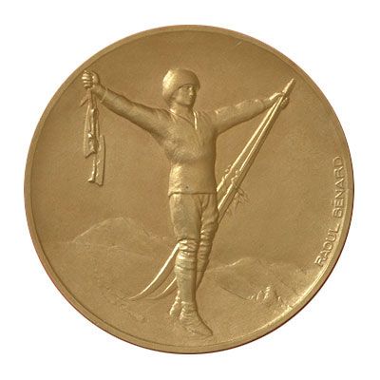
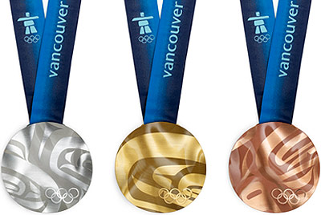
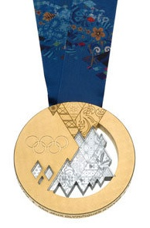
There were 294 competitors and only 13 events at the first Winter Olympics at Chamonix, France.
The XXI Winter Olympics were held in Vancouver (Canada) in 2010.
Russia (Sochi) plays host to the XXII Winter Olympics in 2014.

Slide 11
Do you know that…
The official Olympic flag was flown for the first time during the 1920 Games in Antwerp.
The Olympic Games of 1916, 1940 and 1944 were canceled due to World Wars.
7 new Olympic sports were added at the XXII Winter Olympic Games in Sochi.

Slide 12
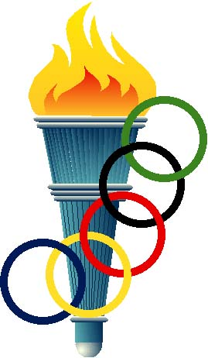
Do you know that…
The top prize at the first modern Olympics was the silver medal.
The 1912 Olympics was the last time that gold medals were solid gold. Ever since, they've been silver with gold plating.
Russian gymnast Larisa Latynina has the most number of over all Olympic medals: 9 Gold, 5 Silver and 4 Bronze.

Slide 13
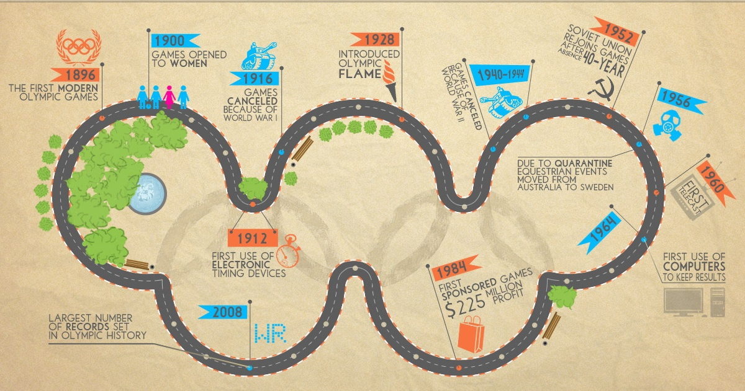
Some more facts about
Olympic Games
http://english-study-cafe.ru/

